Slide 1
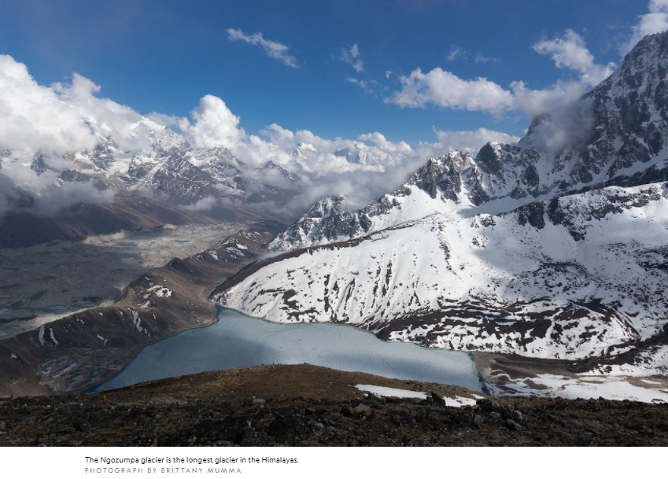
Public Climate Data
Precip data –
﻿National Climatic Data Center Global Historical Climate Network
Climate indices –
National Weather Service
National Centers for Environmental Prediction

Slide 2
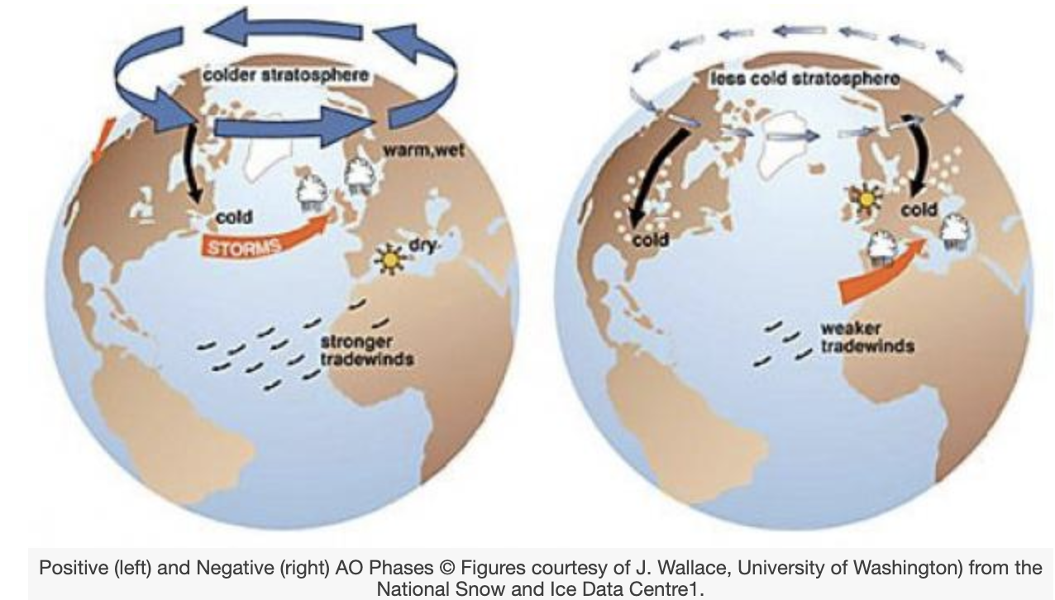
Climate Indices
Synoptic Teleconnections
Climate vs Weather
Regional Climate Interactions
Arctic Oscillation

Slide 3

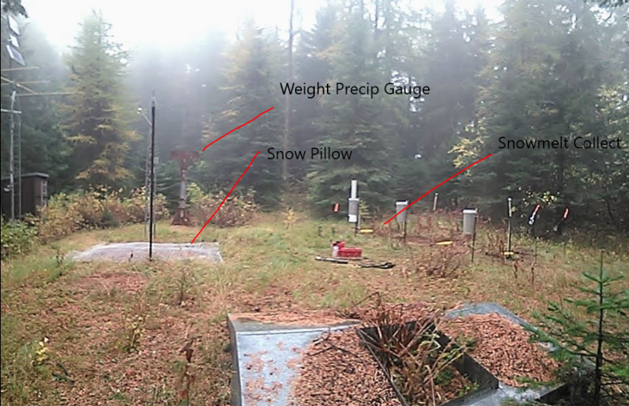
Predictions Depend Understanding Teleconnections

Slide 4
Packages
ulmo - conda install -c conda-forge ulmo
Source https://github.com/ulmo-dev/ulmo
Pandas - conda install –c conda-forge pandas
Numpy - conda install -c conda-forge numpy
Matplot - conda install -c conda-forge matplotlib
Datetime - pip install DateTime

Slide 5
Data
﻿# reach out to the API with cURL command; documentation https://developer.ibm.com/articles/what-is-curl-command/
Run this:
!curl http://www.cpc.ncep.noaa.gov/products/precip/CWlink/daily_ao_index/monthly.ao.index.b50.current.ascii >> 'monthly.ao.index.b50.current.ascii’
Save as a csv in a directory you can access!
We use ﻿ao = np.loadtxt(‘filepath.csv', delimiter=',’) to load it.

Slide 6
Code
https://github.com/philipmoffatt/Climate-Data.git

